Slide 1
Profile Diagram
A SysML example

Slide 2
Index
Design a profile editor
  Standard UML diagrams
    Customization of the palette
  new diagrams
    diagrams extending standards
    totally new diagrams
  current diagrams extended

Slide 3
Index
Design a profile editor
  Standard UML diagrams
    Customization of the palette
  new diagrams
    diagrams extending standards
    totally new diagrams
  current diagrams extended

Slide 4
Standard UML diagrams
The user wants to automatically add element with stereotype
  Custom palette
    Automatic application of the stereotype creation
    Specific palette entry
      → CEA Work
  Problematic
    What happens if the graphical representation changes depending of the applied stereotype to an element ?
    Property View
    Model explorer

Slide 5
Index
Design a profile editor
  standard UML diagrams
    Customization of the palette
  new diagrams
    diagrams extending standards
    totally new diagrams
  current diagrams extended

Slide 6
Diagrams extending standards
If diagrams contains some concepts from a standard diagram
  Examples in SysML
    A Block Definition Diagram extends Class Diagram
    An Internal Block Diagram extends Composite Structure Diagram
Using GMF for first generation
  custom code to plug the diagram to an existing one
  new menu for the creation of diagrams (new id)
    If the profile is applied
The diagram allows new mechanism and disables others
  Delete elements in the palette, disabling drag and drop…

Slide 7
New diagrams
The diagrams provide new Graphical information
They can be created only if the corresponding profile is applied
To be maintainable:
  They need to be generated (using GMF)

Slide 8
General Behavior
Problems
  GMF
    Generates an editor strictly conform to the ecore meta-model
  Static profile
    Specific ecore corresponding to the profile.
    No containment relations for EObject derived from profile
    Solution
      → create “virtual” containment relation with new Meta-model

Slide 9
General Behavior
GMF
  Common case
  With profile
  →Currently, the generators are not implemented
Ecore model
GMF
editor
Ecore
Model
Extended
GMF with custom
Generators
UML
Model
(profile)
Ecore
model
editor
Script

Slide 10
Index
Design a profile editor
  standard UML diagrams
    Customization of the palette
  new diagrams
    diagrams extending standards
    totally new diagrams
  current diagrams extended

Slide 11
Current diagrams extended
Diagram behavior / appearance changes when a profile is applied
  The diagram is the same (no new menu)
  Necessity to design extension point in diagram generation to make dynamic a diagram
    Example of Activity diagram

Slide 12
TODO …
What is the expected result
  if a profile is unapplied ?
  if a stereotype is unapplied ?
  …

Slide 13
Example
In SysML
  Parametric Diagram is a new Diagram
  Activity Diagram changes when SysML profile is applied
  Block Definition Diagram inherits from Class Diagram
  Internal Block Diagram inherits from Composite Structure Diagram

Slide 14
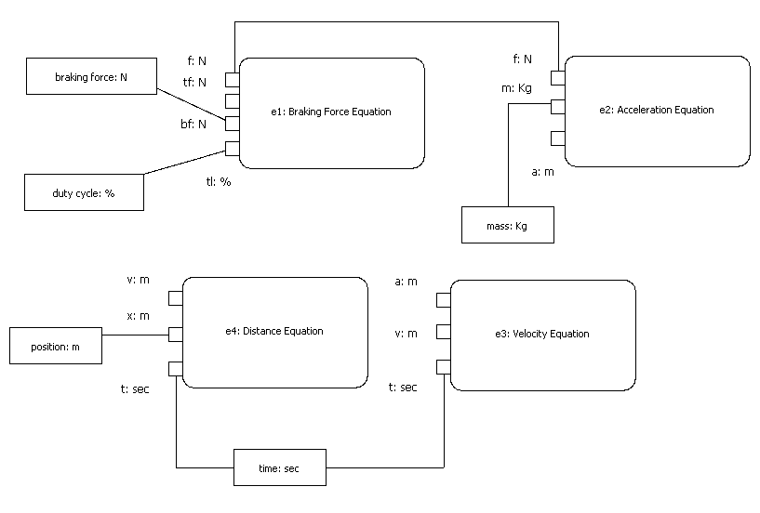
Example - Snapshots
Parametric Diagram

